Slide 1
Automated Machine Learning
Overview of AutoML Tools and Techniques

Slide 2
Agenda
Introduction to AutoML
AutoML libraries
AutoSklearn
H2O
AWS AutoML tools
AWS Canvas
AWS SageMaker Autopilot

Slide 3
What is AutoML?
Automated Machine Learning, also referred to as Automated ML or AutoML, is technology to:
Automate machine learning tasks
Accelerate the model-building process
Help data scientists focus on higher value-added duties
Improve the accuracy of ML models

Slide 4
What is AutoML?
AutoML is growing because:
Usability: providing machine learning as a tool to non-machine learning experts
Productivity: increasing the productivity of machine learning engineers
Performance: finding better machine learning models

Slide 5
Benefits of AutoML
Automation
AutoML automates the process of ML.
This saves time and effort compared to manual model selection and tuning.
Accessibility
AutoML makes it easier for non-experts to use machine learning.
Speed
AutoML can deliver results faster than manual ML.
Scalability
AutoML can handle large datasets and complex models, making it useful for organizations with a lot of data to process.
Consistency
AutoML can deliver consistent results, as it removes the risk of human error in model selection and tuning.

Slide 6
Limitations of AutoML
Limited customization
AutoML may not provide the level of customization that manual machine learning can.
It automates many of the choices made during model selection and tuning.
Black box models
AutoML may produce models that are difficult to interpret
Cost
AutoML solutions can be expensive
Over-reliance
Users may become over-reliant on AutoML and not have a deep understanding of the underlying principles of ML.
Limited problem scope
AutoML may not be suitable for all machine learning problems

Slide 7
Different types of AutoML techniques
Overview of different types of AutoML techniques:
Data Preparation
Feature engineering
Model selection
Hyperparameter tuning
Automated pipeline optimization
Selection of evaluation metrics and validation procedures
Problem checking
Analysis of obtained results
Creating user interfaces and visualizations

Slide 8
Example: Automated Data Preparation and Feature Engineering
feature 1 | feature 2 | feature 3 | feature 4 | feature 5 | target
1 | nan | 1 | high | 0.2 | A
3 | nan | 5 | low | nan | B
4 | nan | nan | high | 0.4 | nan
10 | 5 | 6 | middle | 4.7 | A
feature 1 | feature 3 | high | middle | low | feature 5 | target
1 | 1 | 1 | 0 | 0 | 0.2 | 1
3 | 5 | 0 | 0 | 1 | 2.45 | 0
10 | 6 | 0 | 1 | 0 | 4.7 | 1

Slide 9
Automated Machine Learning
Automated Machine Learning with auto-sklearn, HO2, Auto Keras

Slide 10
AutoML libraries
There are different types of AutoML frameworks
AutoWEKA
H2O.ai
Auto Sklearn
Auto Pytorch
Auto Keras
TPOT
Google AutoML
AWS Canvas
AWS Autopilot
…
Let’s go over some of these..

Slide 11
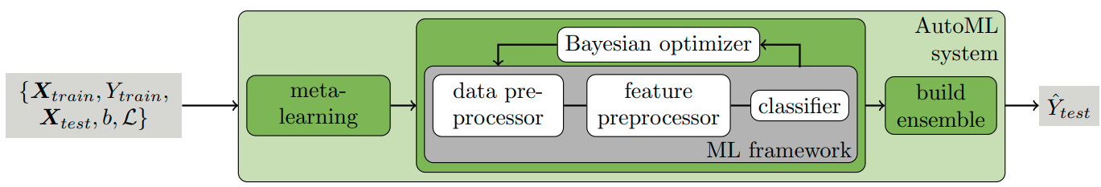
AutoML libraries: Auto-sklearn
Auto-sklearn is an open-source AutoML library
It is built on top of scikit-learn
It is written in Python
Auto-sklearn is based on defining AutoML as a CASH problem:
CASH = Combined Algorithm Selection and Hyperparameter optimization
image: https://ml.informatik.uni-freiburg.de/wp-content/uploads/papers/15-NIPS-auto-sklearn-preprint.pdf

Slide 12
Auto-sklearn
It is the result of research at the University of Freiburg
It was introduced by Feurer
Auto-sklearn does not focus on neural architecture search (like Auto-Keras does)
It supports XGBoost
Installation:
pip install auto-sklearn
conda install gxx_linux-64 gcc_linux-64 swig

Slide 13
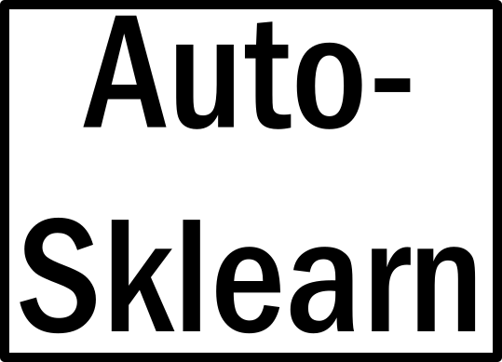
Auto-sklearn: How does it work?
Auto-sklearn has three main components:
Meta-learning
Extraction of meta-feature to find the similarity of the new dataset to the knowledge base relying on meta-learning
Bayesian optimization
Bayesian optimization will try to find and select the out-performing ML pipelines
Build ensemble
Build the ensemble model based on the best ML workflow in the search space

Slide 14
Auto-sklearn: Features
Some main features of auto-sklearn:
Useful for many tasks, such as
Classification
Regression
Multi-label classification
Consists of several preprocessing methods
Handling missing values
Normalizing data
Searches for optimal ML pipelines among a considerable search space
15 classifiers
More than 150 hyperparameters are searched
State of the art
Meta-learning
Bayesian optimization
Ensemble techniques

Slide 15
Auto-sklearn: Newer version V2
Four main improvements in V2 of auto-sklearn:
Introduced early-stopping strategy inside the whole search space
Improving model selection strategy
Building a portfolio instead of using meta-feature
In order to find a similar dataset in the knowledge base
Build an automated policy selection
Based on the previous improvements to select the best strategy

Slide 16
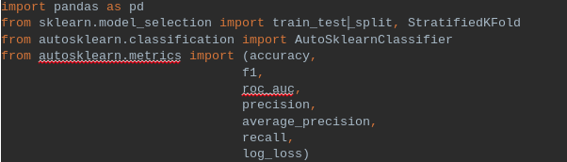
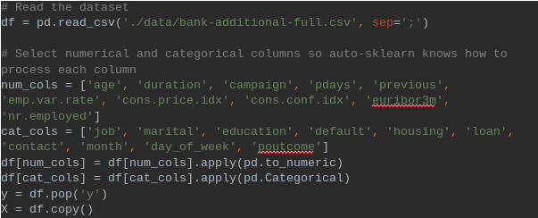
Auto-sklearn: How to use?
Import necessary libraries:
Read and prepare data:

Slide 17

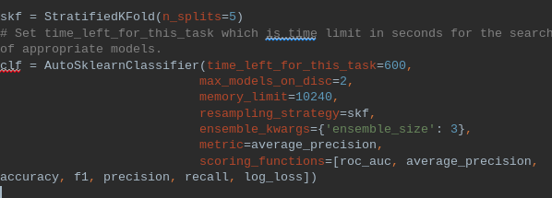
Auto-sklearn: How to use?
Split data into train/test datasets:
Set up auto-sklearn classifier:

Slide 18
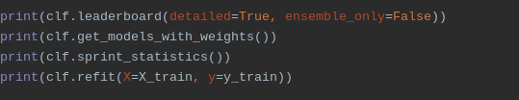

Auto-sklearn: How to use?
Fit classifier and print results
Use leaderboard to explore the results in more details

Slide 19

AutoML Libraries: AutoKeras
Introduction
AutoKeras is a Keras-based open-source AutoML framework.
It was designed by the DATA Lab at Texas A&M University
AutoKeras specialises in Deep Learning
AutoKeras is build on Tensorflow

Slide 20
AutoKeras
Neural Network architecture
AutoKeras chooses the layout of the layers and the number of neurons
Data Preparation
AutoKeras automatically do data preparation
If a column in your data contains text, it will convert it into an embedding
If the column values are fixed categories, it will convert them into one-hot encoding

Slide 21
AutoKeras
AutoKeras is built around four key characteristics:
It provides a straightforward and user-friendly API
Users with little programming knowledge can quickly learn how to use it
Advanced users can modify lower-level system parameters
It can operate both locally and in the cloud
It is based on a dynamic configuration
It adjusts the size of the neural architecture dependent on the amount of GPU memory available
The open-source community actively develops and maintains it.

Slide 22
AutoKeras: Installation
Requirements:
Python3
Tensorflow >= 2.3.0
GPU Setup (optional)
Install AutoKeras
pip install git+https://github.com/keras-team/keras-tuner.git
pip install autokeras

Slide 23
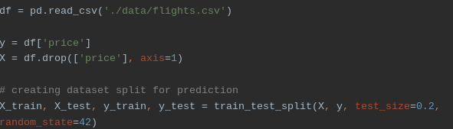
AutoKeras: How to use?
Let’s show how to build regression model
Read data, split it into train/test datasets

Slide 24
AutoKeras: How to use?
Initialize the StructuredDataRegressor
Search for the best model.

Slide 25
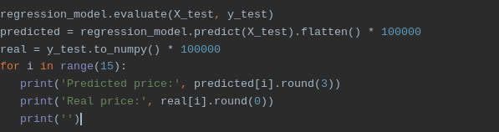
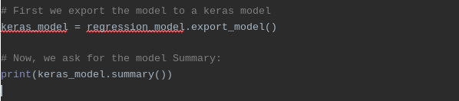
AutoKeras: How to use?
Evaluate the model
Export the model and check the summary

Slide 26
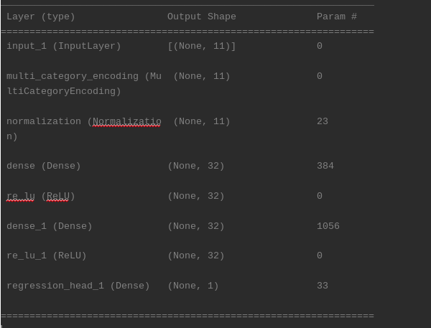
AutoKeras: Summary output

Slide 27
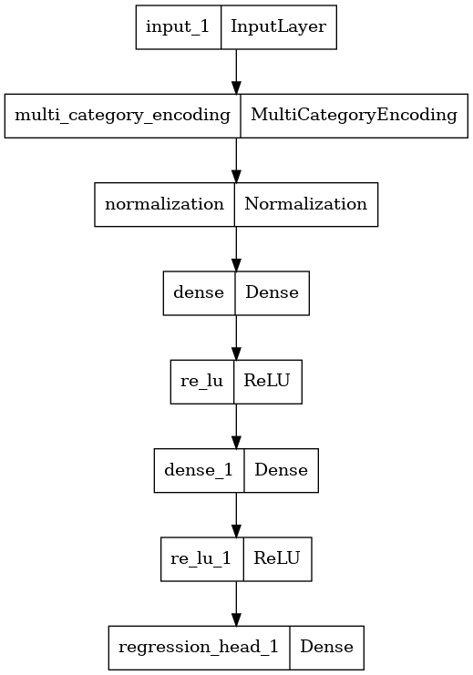
AutoKeras: Summary output - plot
You can export

Slide 28
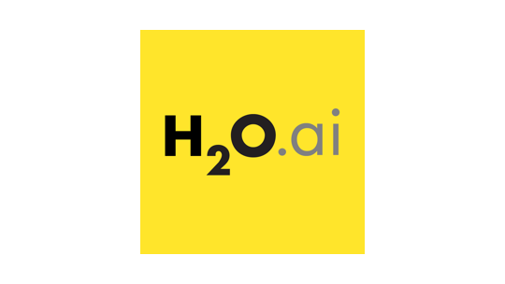
AutoML libraries: H2O
H2O is an open-source ML platform
H2O automates entire ML process
data preparation
feature engineering
model selection
hyperparameter tuning
Automatic data preprocessing
Imputation
one-hot encoding
standardization
Tunes individual models using cross-validation
H2O explains models using the “H2O Explainability” module

Slide 29
AutoML libraries: H2O
H2O is available for R and Python
The algorithms are implemented on top of H2O's distributed Map/Reduce framework
It uses the Java Fork/Join framework for multi-threading
The data is:
Read in parallel
Distributed across the cluster
Stored in memory in a columnar format in a compressed way
H2O's data parser has built-in intelligence to guess the schema of the incoming dataset.

Slide 30
AutoML libraries: H2O
GPU for training on H2O can be used only with:
NVIDIA GPUs (GPU Cloud, DGX Station, DGX-1, or DGX-2)
CUDA 8
Supported Data Types:
Numerical
Categorical
Textual (for Word2vec)

Slide 31
AutoML libraries: H2O
The current version of AutoML trains and cross-validates the following algorithms:
Three pre-specified XGBoost GBM (Gradient Boosting Machine) models
Fixed grid of Generalized Linear Models (GLMs)
Default Random Forest (DRF)
Five pre-specified H2O Gradient Boosting Machines (GBMs)
Default Deep Neural Net
Extremely Randomized Forest (XRT)
Random grid of XGBoost Gradient Boosting Machines
Random grid of H2O Gradient Boosting Machines
Random grid of Deep Neural Nets

Slide 32
H2O: Supervised Algorithms
List of supervised learning algorithms:
Cox Proportional Hazards (CoxPH)
Deep Learning (Neural Networks)
Distributed Random Forest (DRF)
Generalized Linear Model (GLM)
Isotonic Regression
ModelSelection
Generalized Additive Models (GAM)
ANOVA GLM
Gradient Boosting Machine (GBM)
Naïve Bayes Classifier
RuleFit
Stacked Ensembles
Support Vector Machine (SVM)
Distributed Uplift Random Forest (Uplift DRF)
XGBoost

Slide 33
H2O: Unsupervised Algorithms
List of unsupervised learning algorithms:
Aggregator
Generalized Low Rank Models (GLRM)
Isolation Forest
Extended Isolation Forest
K-Means Clustering
Principal Component Analysis (PCA)

Slide 34
H2O: Miscellaneous
List of other algorithms and feature engineering techniques:
Target Encoding
TF-IDF
Word2vec
Permutation Variable Importance

Slide 35
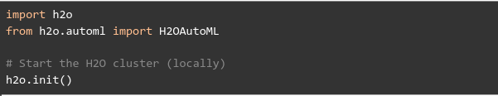
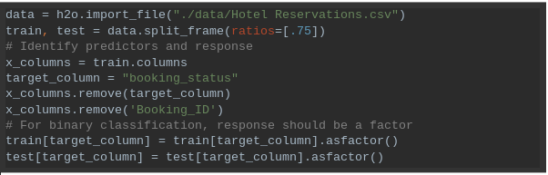
H2O: How to start?
In Python: start the H2O cluster firstly
Load the data

Slide 36


H2O: Train the model
Run AutoML with specified number of models to try
Run predictions on test dataset
Get the best model with default criteria metric and than with desired (example: aucpr - The area under the precision-recall curve )

Slide 37

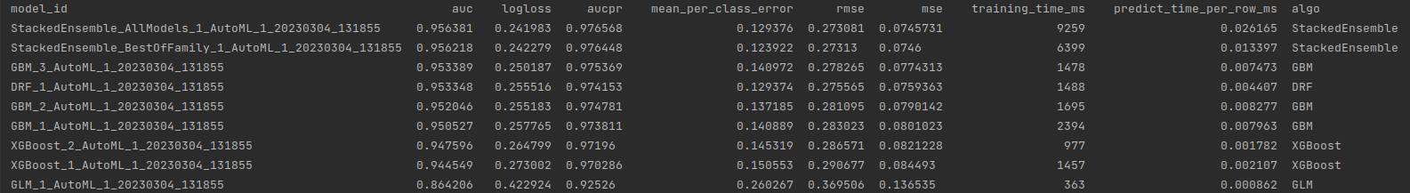
H2O: Get the results from leaderboard for AutoML
Get leaderboard with all possible columns
Results

Slide 38
H2O: Save the model
There options:
Save to bin file
Save to Hadoop Distributed File System (HDFS)
Save to Model Object, Optimized (MOJO)
Not all algorithms are supported by MOJO

Slide 39
Automated Machine Learning
AWS AutoML

Slide 40
AWS AutoML
AWS has multiple AutoML tools:
Amazon SageMaker Ground Truth
Amazon SageMaker Autopilot
Amazon SageMaker Canvas
Amazon SageMaker Studio
…
Let’s take a look at Canvas and Autopilot

Slide 41
AWS AutoML: Canvas
AWS Canvas ML tool that allows you to visually design your serverless applications using a drag-and-drop interface.
SageMaker Canvas leverages the same technology as Amazon SageMaker
It supports multiple problem types such as:
binary classification
multi-class classification
numerical regression
time series forecasting

Slide 42
AWS AutoML: Canvas
In SageMaker Canvas, you do the following:
Import your data (from S3 or drag-drop from local)
Build a predictive model
Evaluate the model's performance
Import more data
Train another model

Slide 43
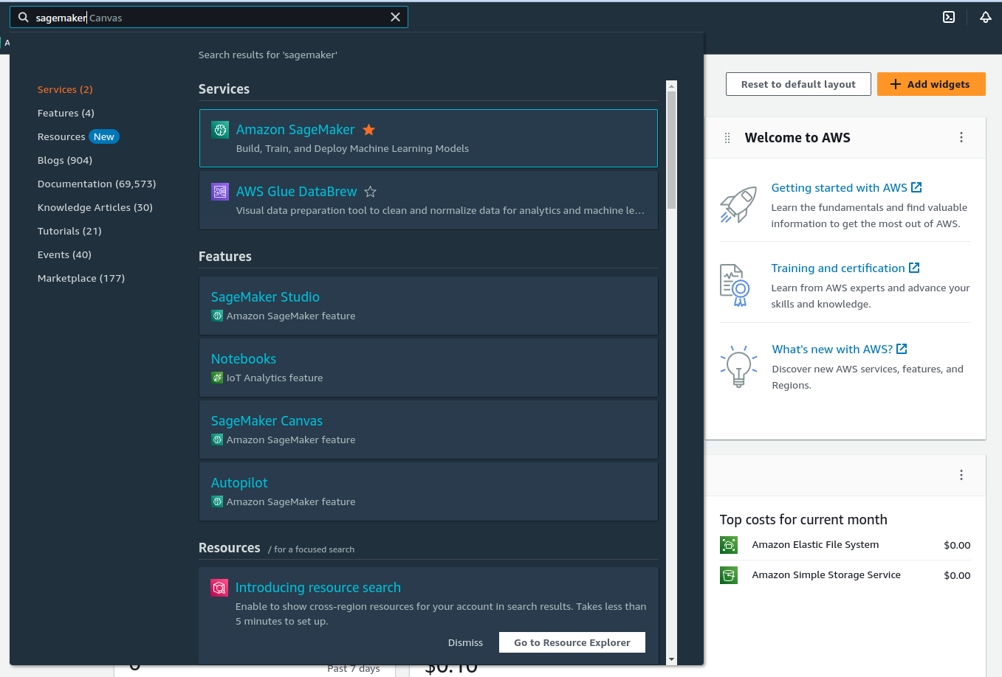
AWS Canvas: Step 1: Search for SageMaker

Slide 44
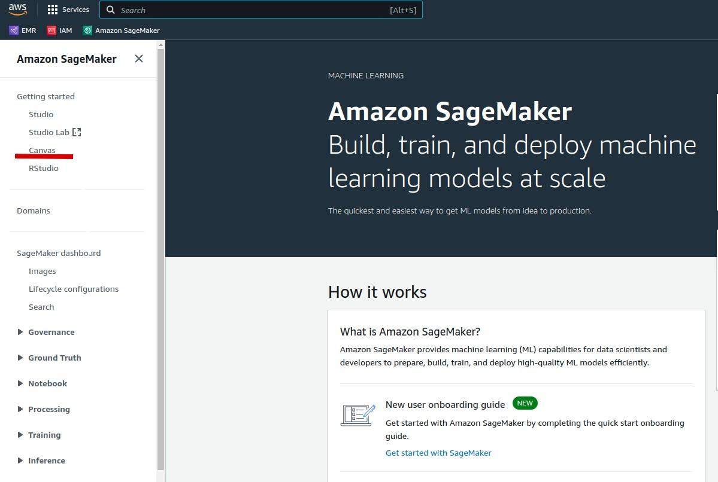
AWS Canvas: Step 2: Select Canvas

Slide 45
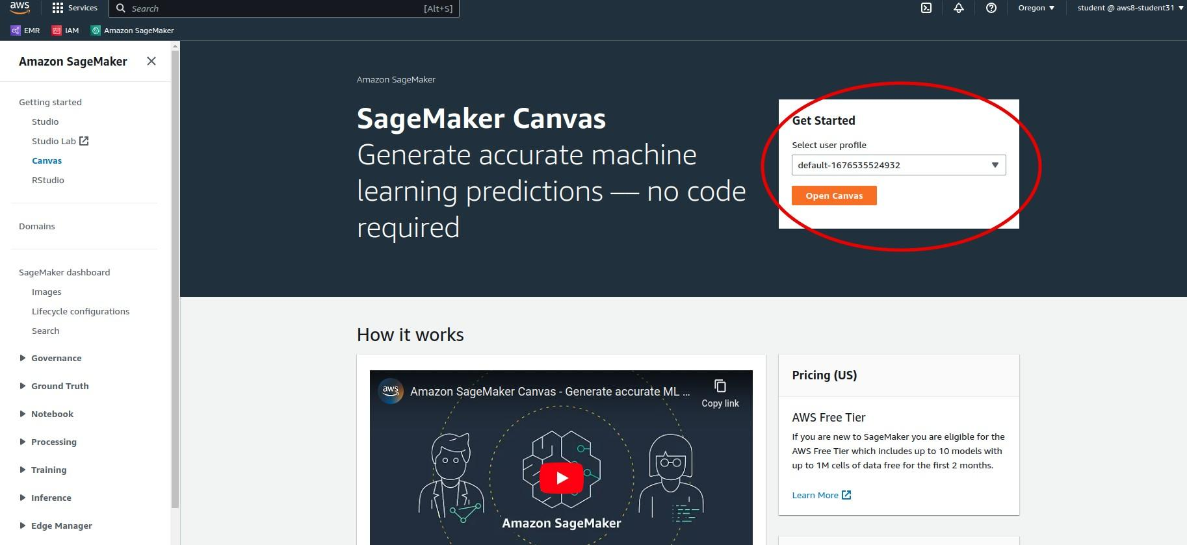
AWS Canvas: Step 3: Choose User (needs to be created before)

Slide 46
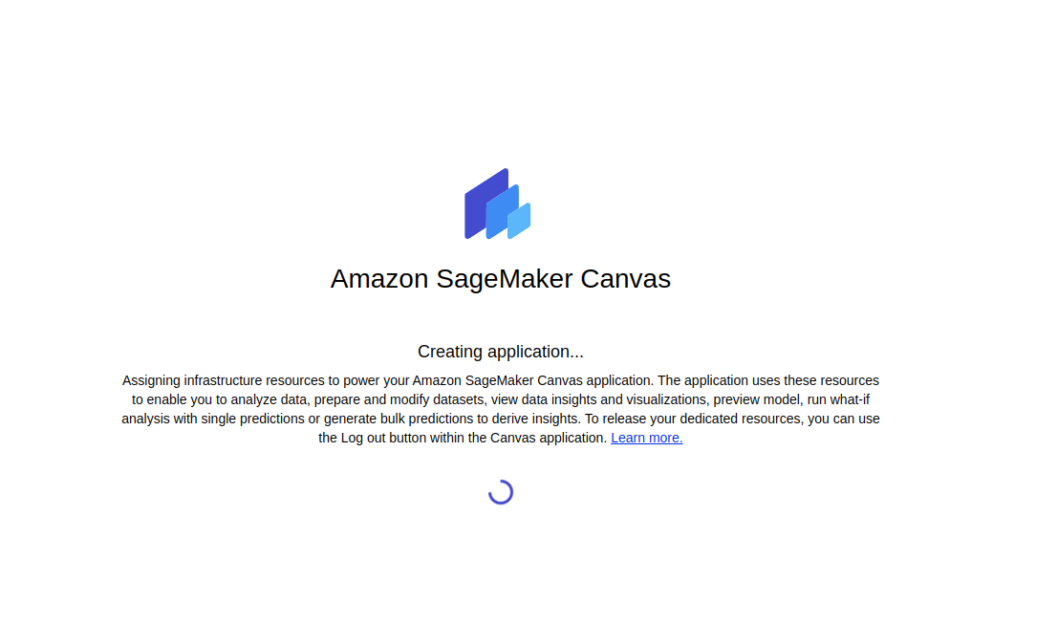
AWS Canvas: Step 4: AWS Canvas would start

Slide 47
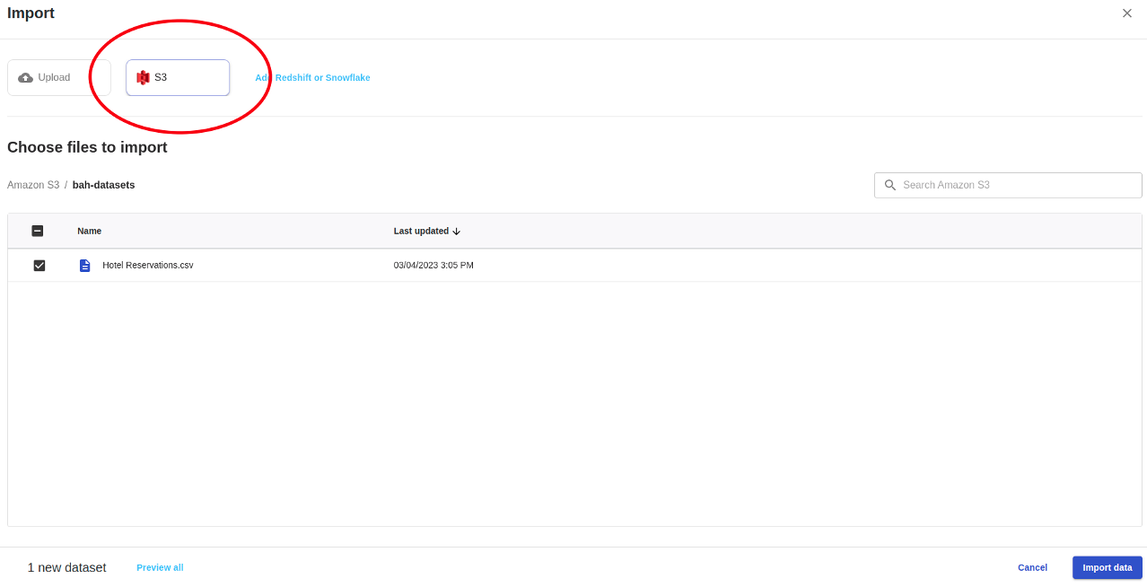
AWS Canvas: Step 5: Import dataset (from S3 or Upload from local)

Slide 48
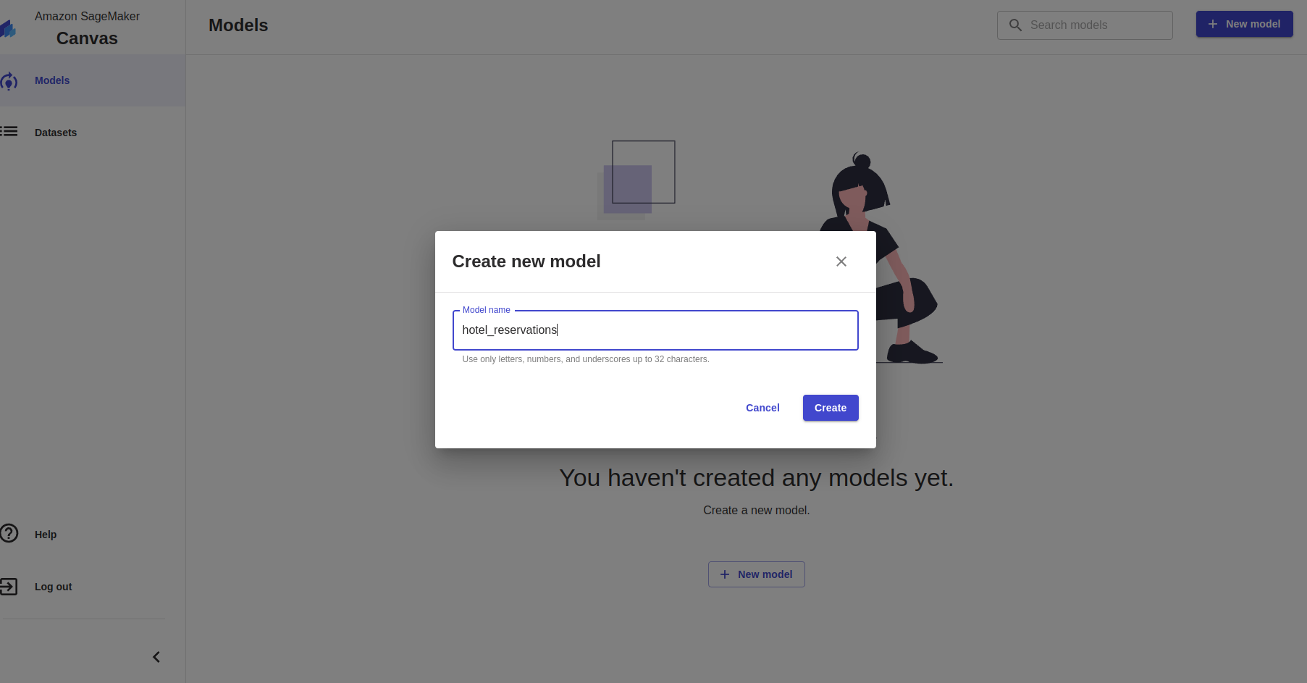
AWS Canvas: Step 6: Build the model - set name

Slide 49
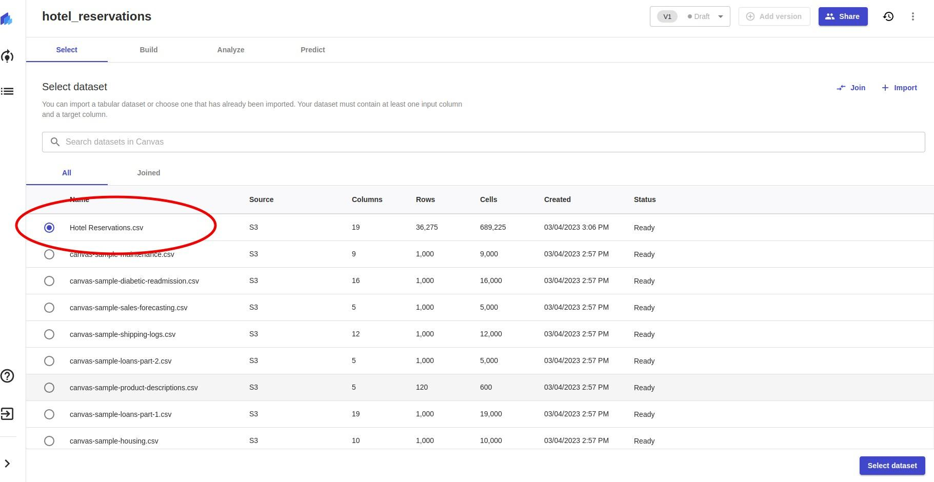
AWS Canvas: Step 7: Build the model - select dataset

Slide 50
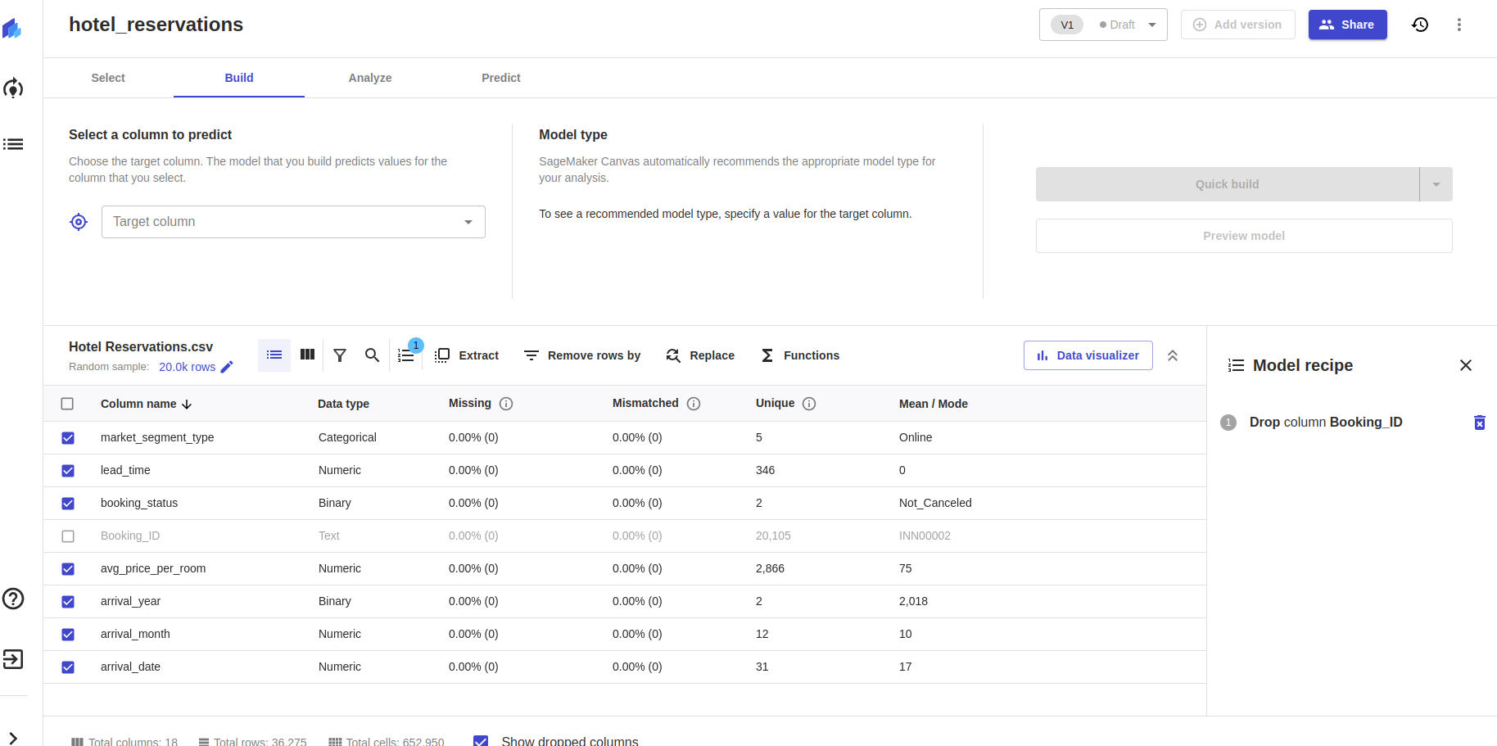
AWS Canvas: Step 8: Build the model - drop unwanted columns

Slide 51
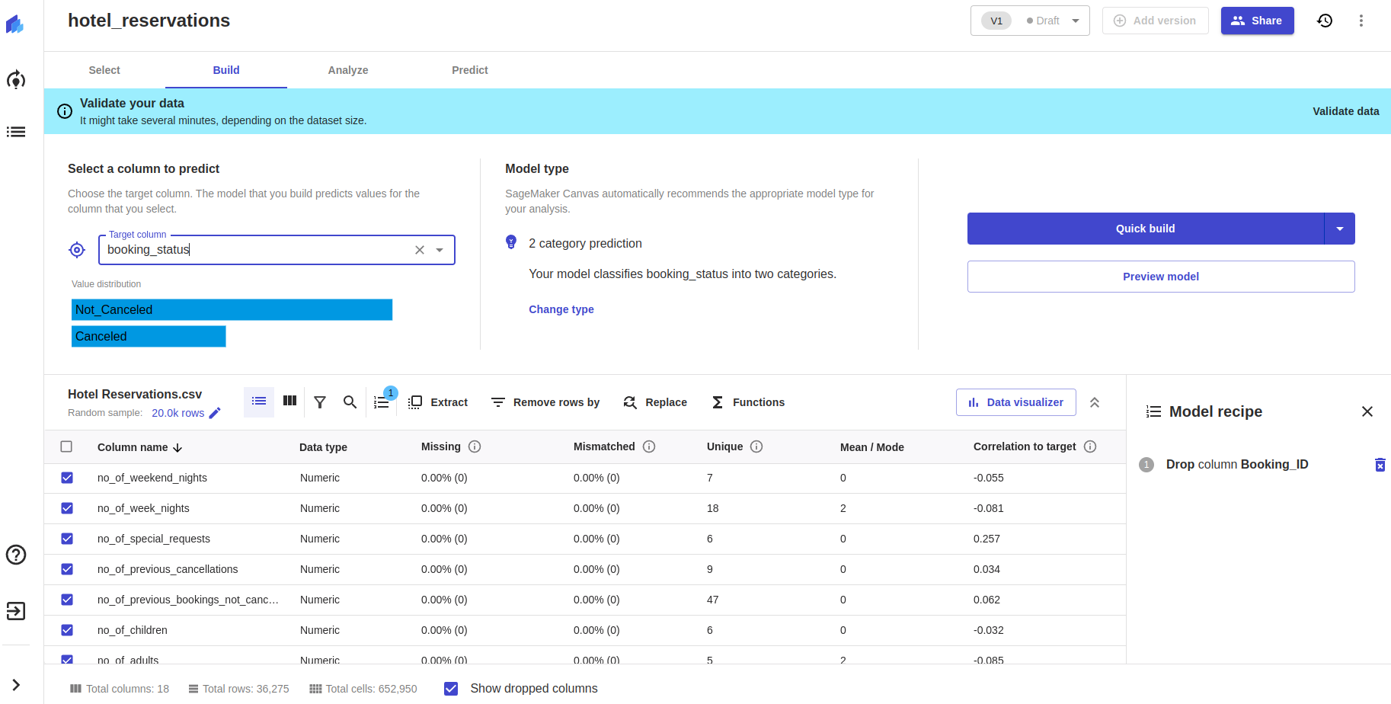
AWS Canvas: Step 9: Build the model - select target column

Slide 52
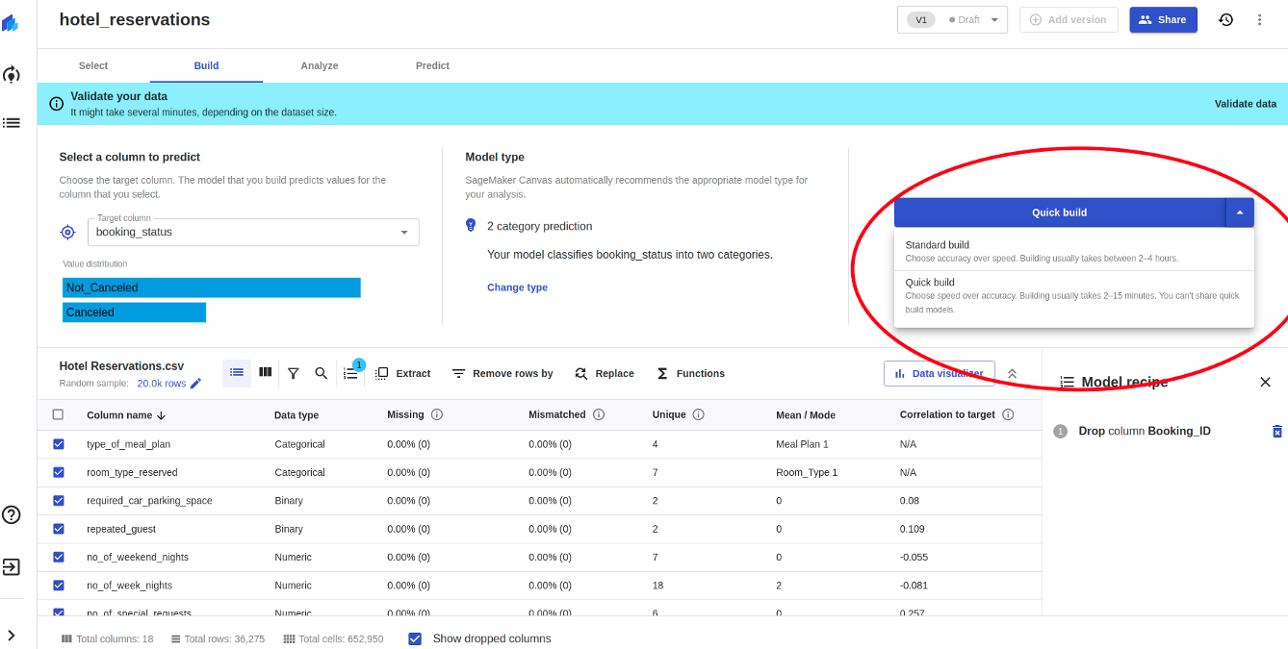
AWS Canvas: Step 10: Build the model - Quick build vs Standard build

Slide 53
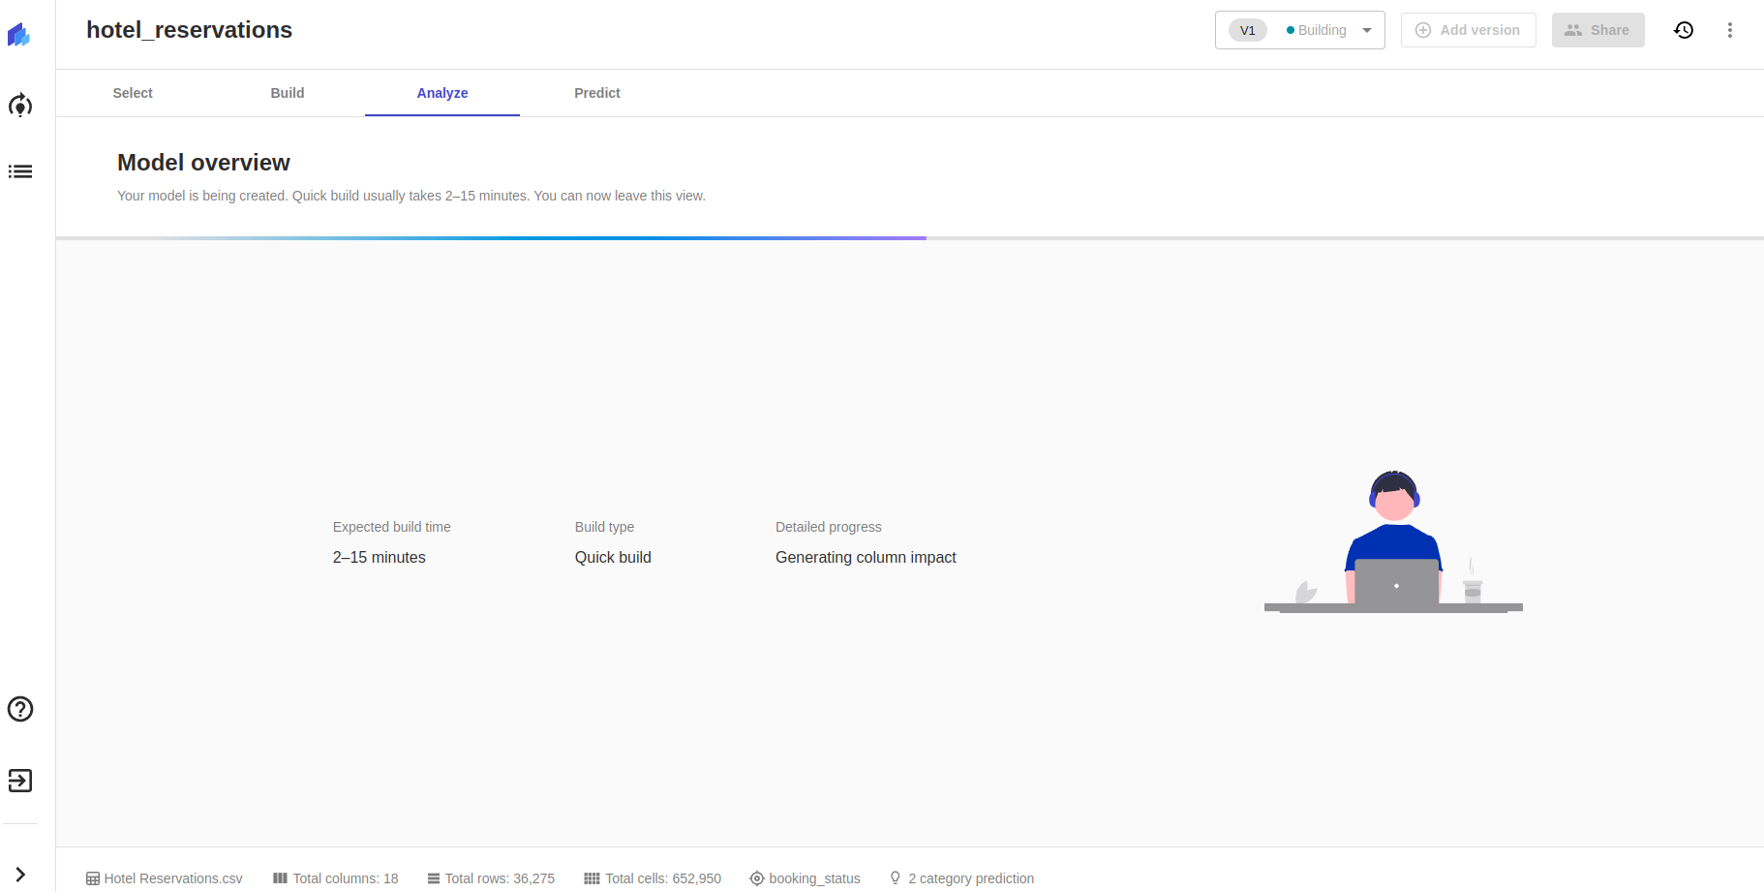
AWS Canvas: Step 11: Build the model - Wait 2-15 mins (quick mode)

Slide 54
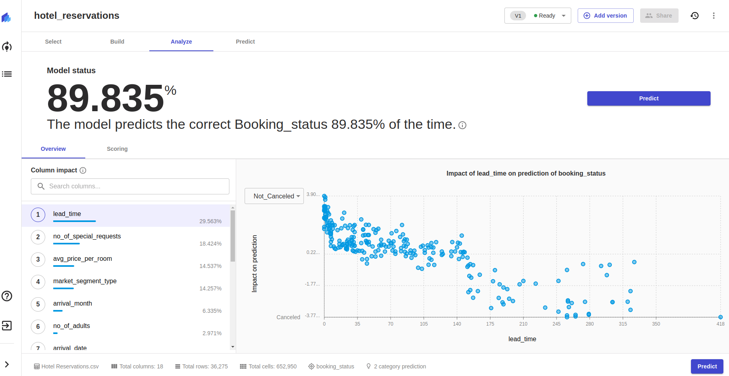
AWS Canvas: Step 12: Build the model - Model finished - analysis

Slide 55
AWS AutoML: Autopilot
What is Autopilot?
Amazon SageMaker Autopilot is a feature-set that automates key tasks of an automatic machine learning (AutoML) process using AWS SageMaker in background.
AWS Autopilot will:
Explore your data
Select the algorithms relevant to your problem type
Prepare the data to facilitate model training and tuning
Directly deploy the model to production with just one click

Slide 56
AWS AutoML: Autopilot
Key features:
Automatic data pre-processing and feature engineering
Automatic ML model selection
Classification, multi-class classification, regression
Model leaderboard
Review all the ML models
Feature importance
Explainability report
Customizable autoML journey
Customize steps in autoML
Automatic notebook creation
Automatically generate a Amazon SageMaker Studio Notebook

Slide 57
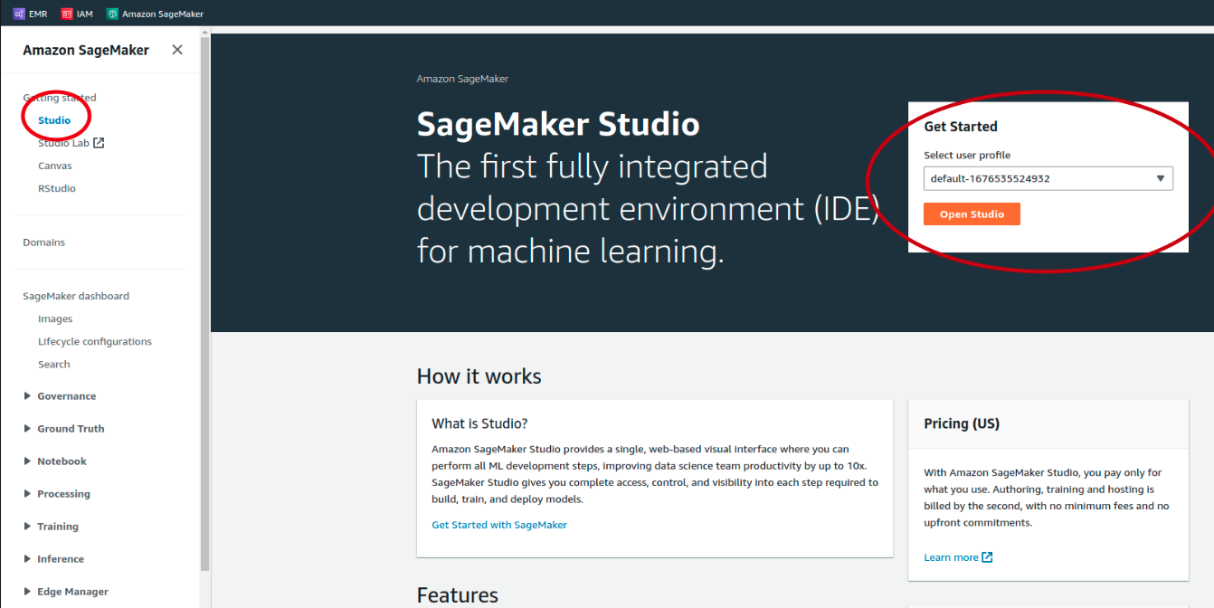
AWS Autopilot: Step 1: Start Autopilot

Slide 58
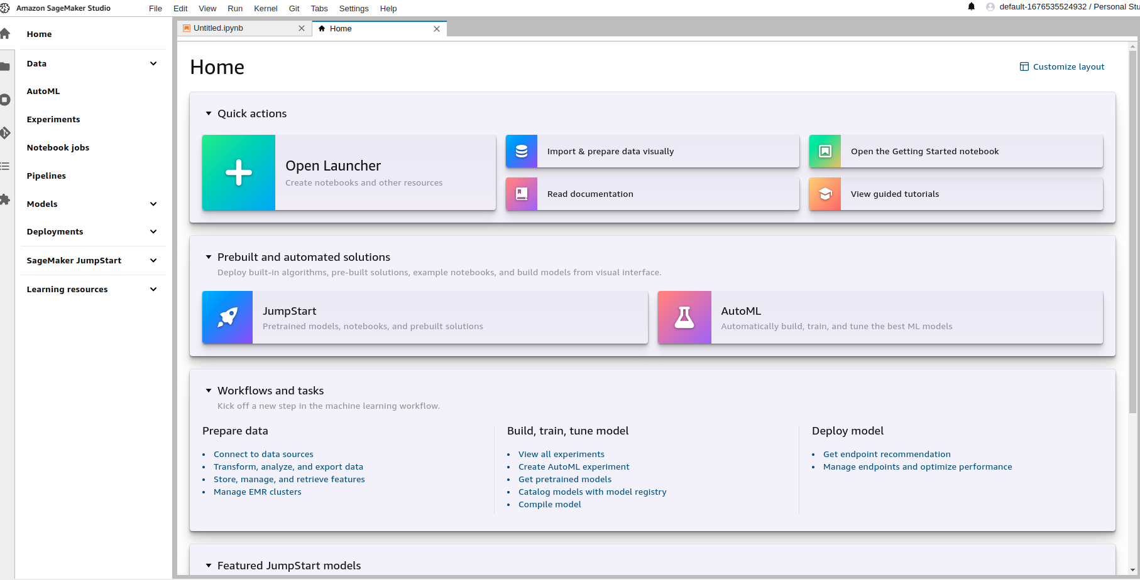
AWS Autopilot: Step 2: Autopilot studio

Slide 59
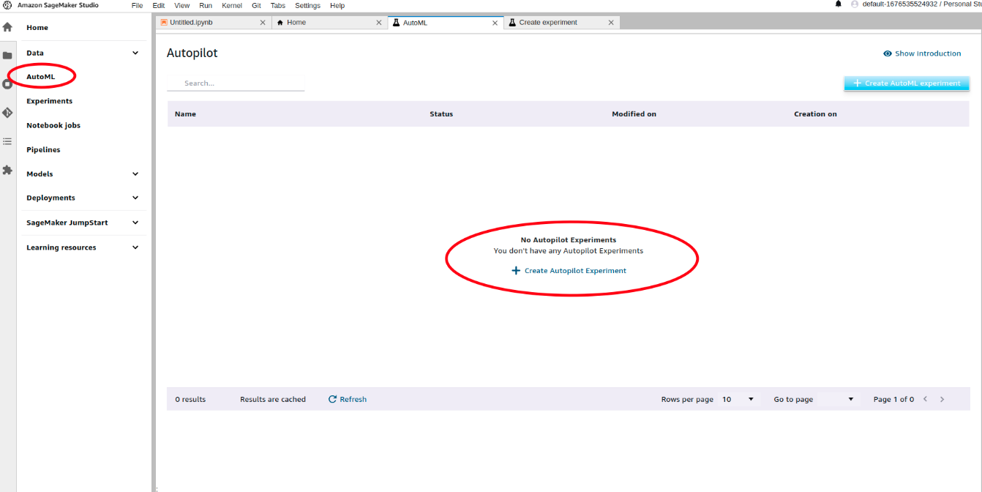
AWS Autopilot: Step 3: Run experiment

Slide 60
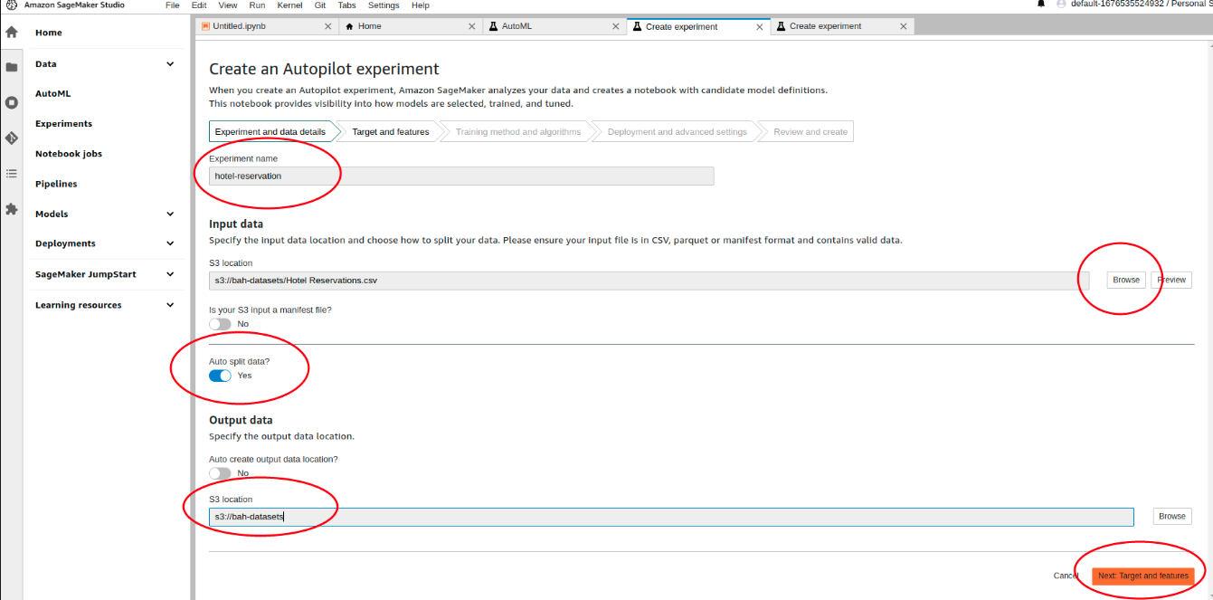
AWS Autopilot: Step 4: Create Experiment

Slide 61
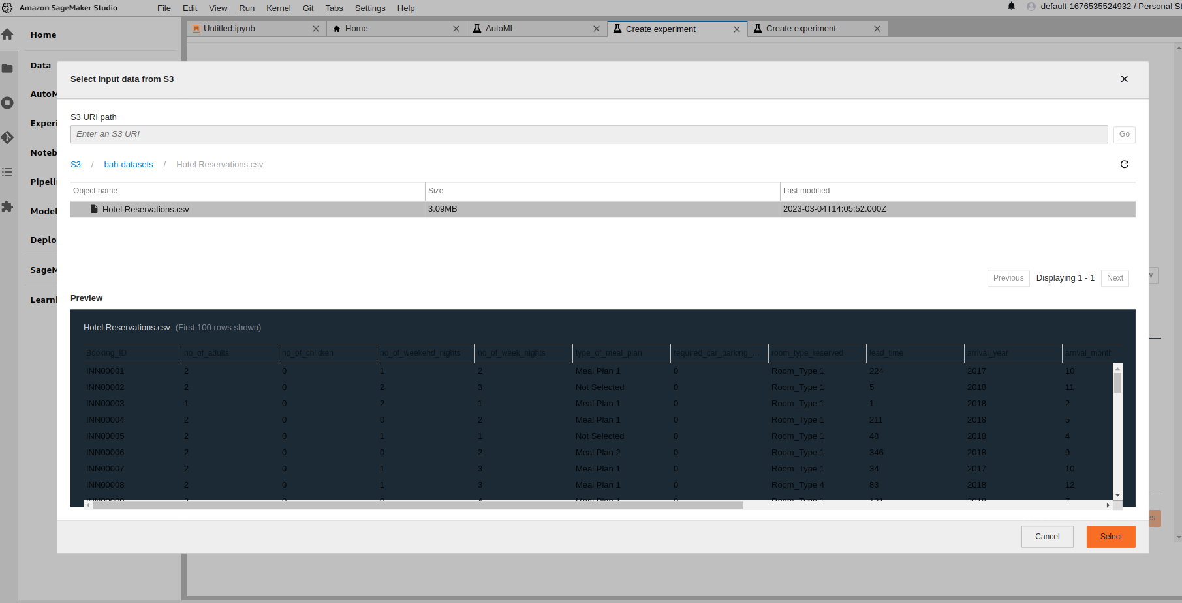
AWS Autopilot: Step 5: Load the data

Slide 62
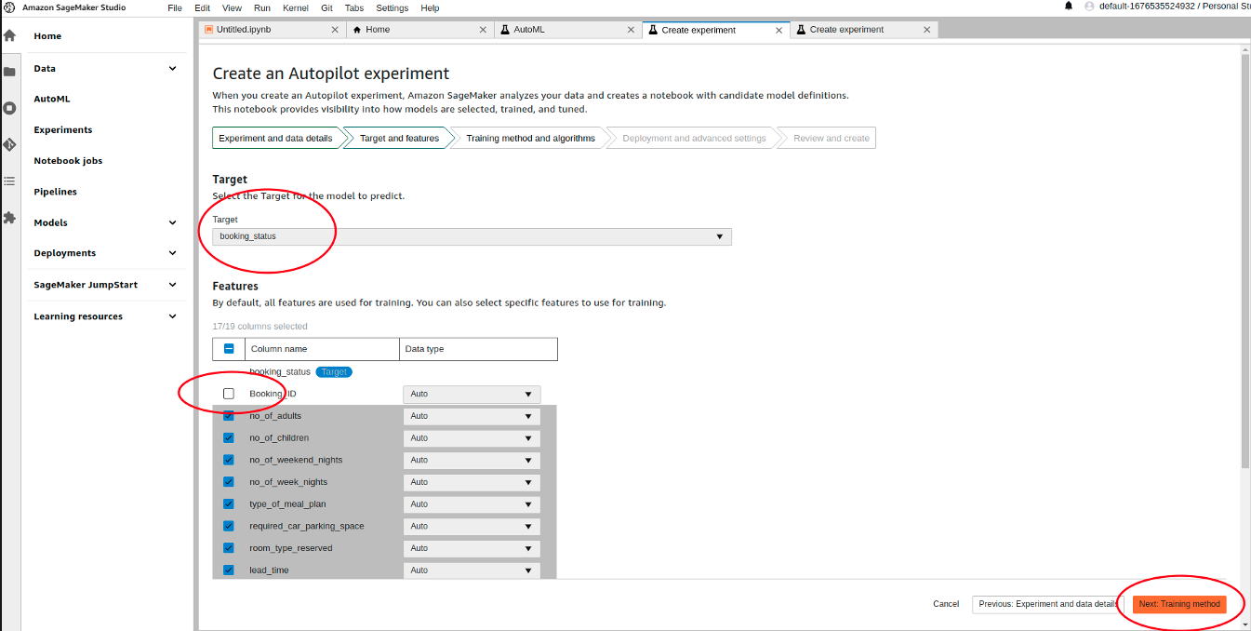
AWS Autopilot: Step 6: Set target column/remove unwanted columns

Slide 63
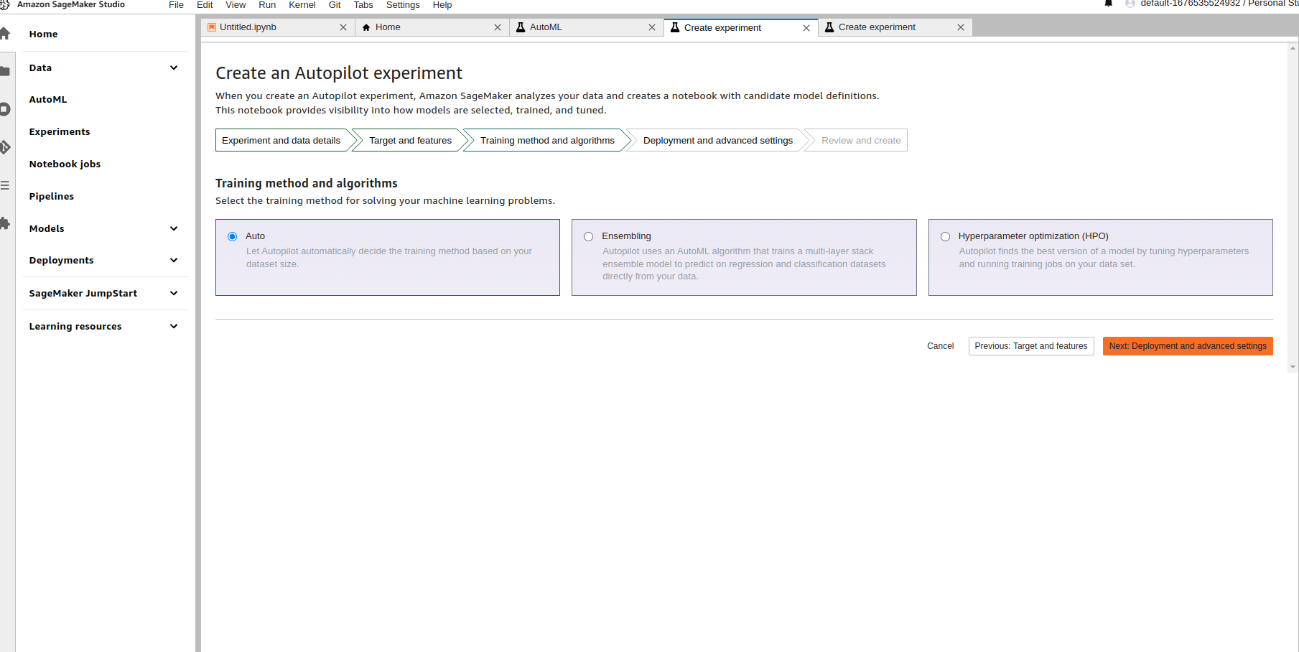
AWS Autopilot: Step 7: Choose Training method

Slide 64
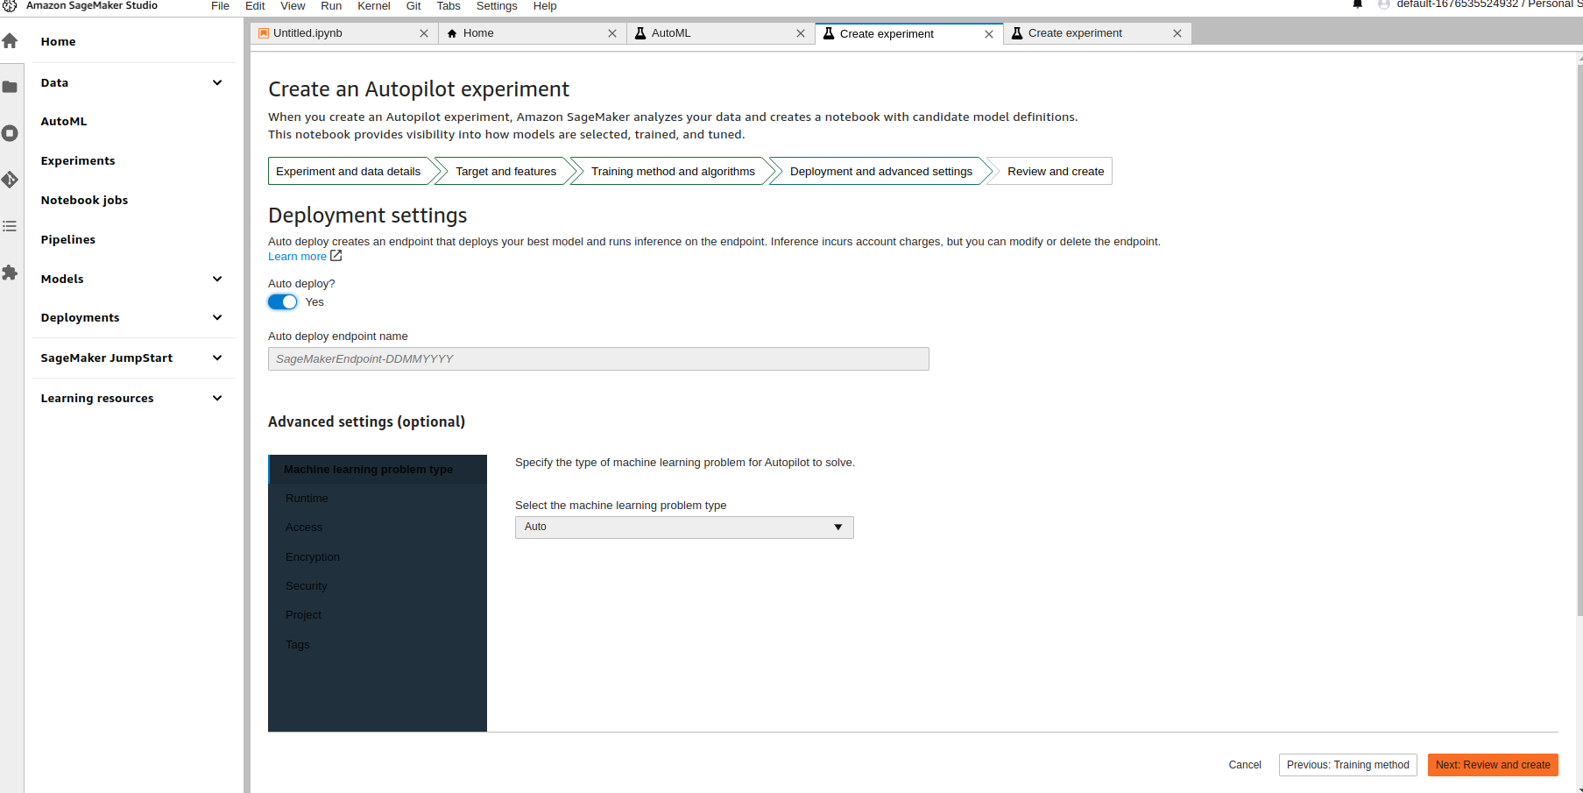
AWS Autopilot: Step 8: Set Deployment settings

Slide 65
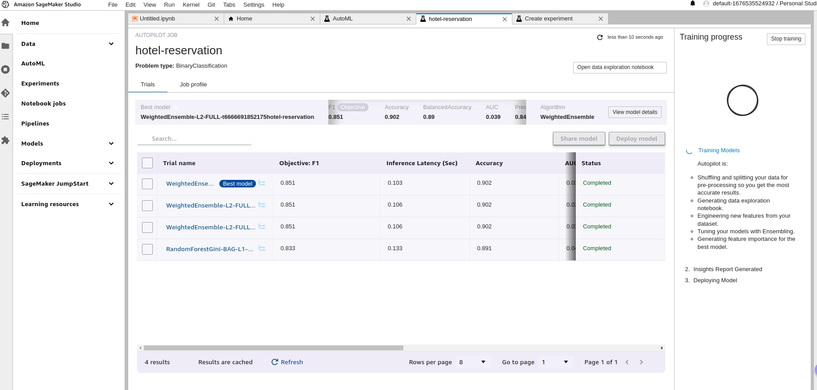
AWS Autopilot: Step 9: Results

Slide 66
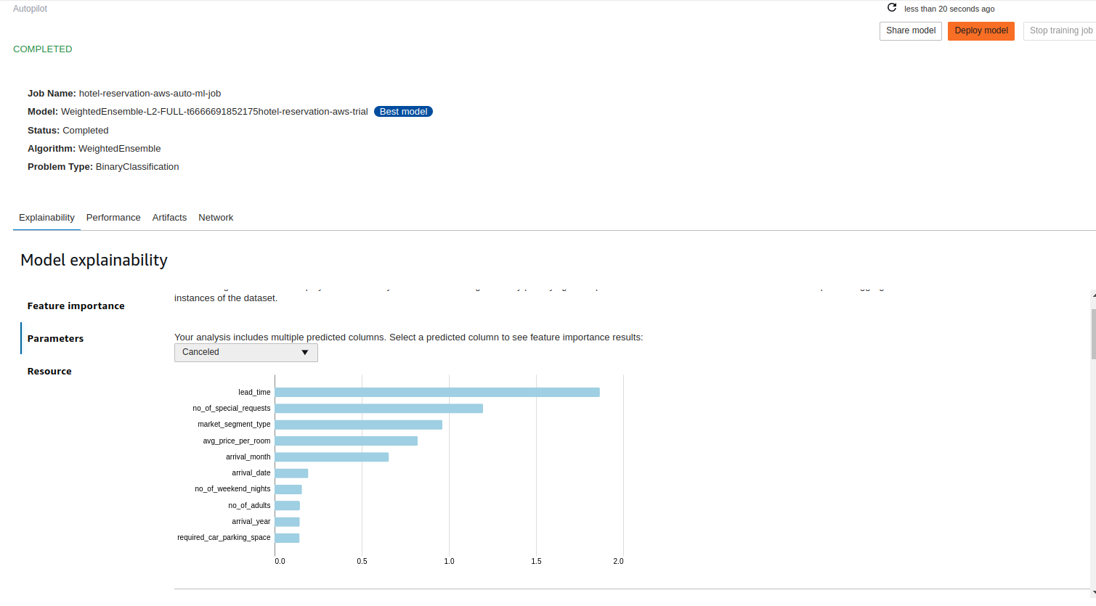
AWS Autopilot: Step 10: Model Explainability

Slide 67
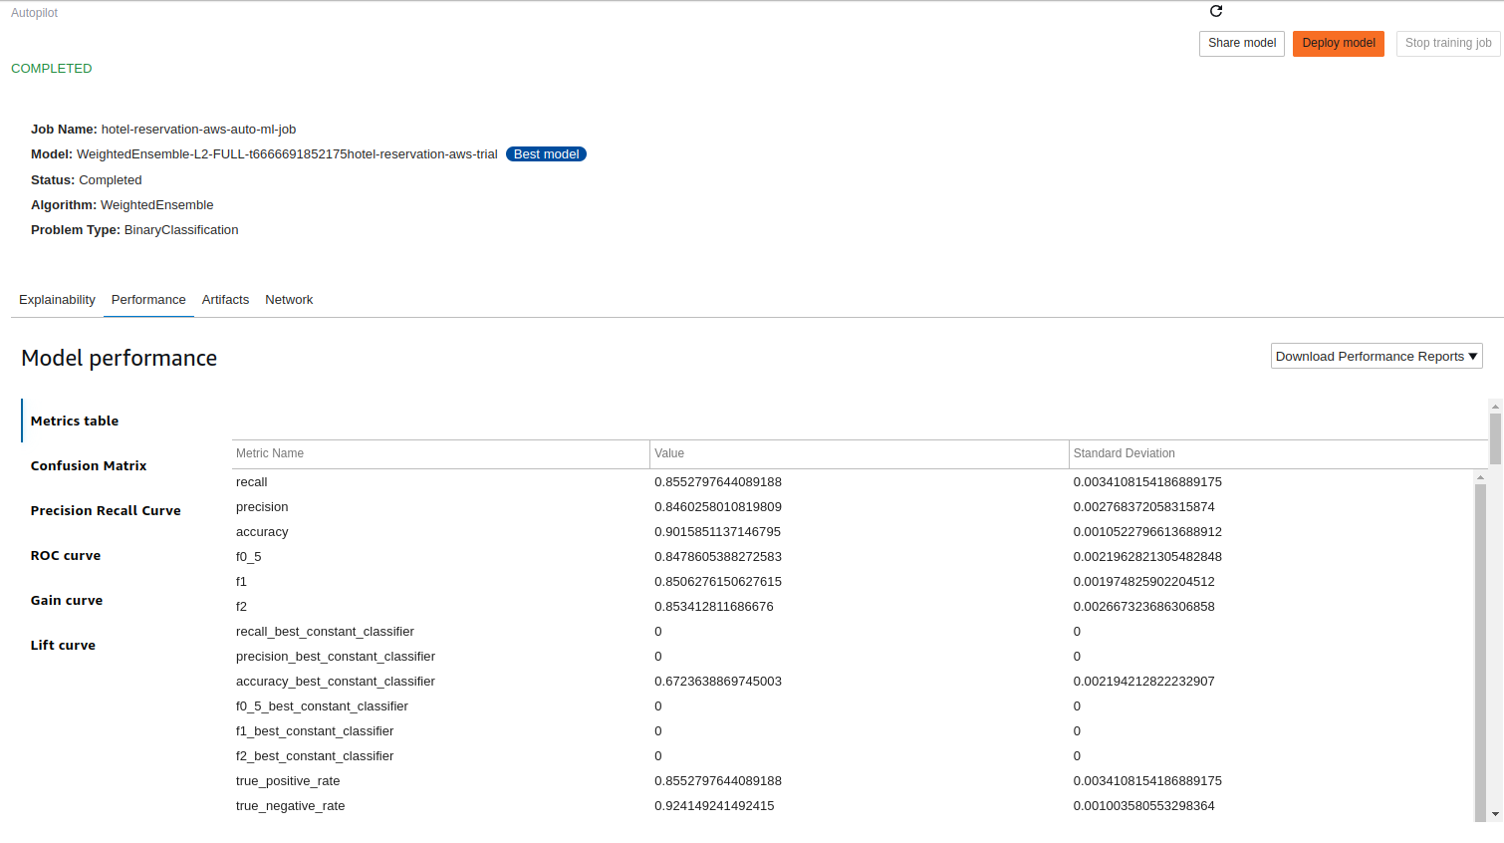
AWS Autopilot: Step 11: Model Performance - Metrics table

Slide 68
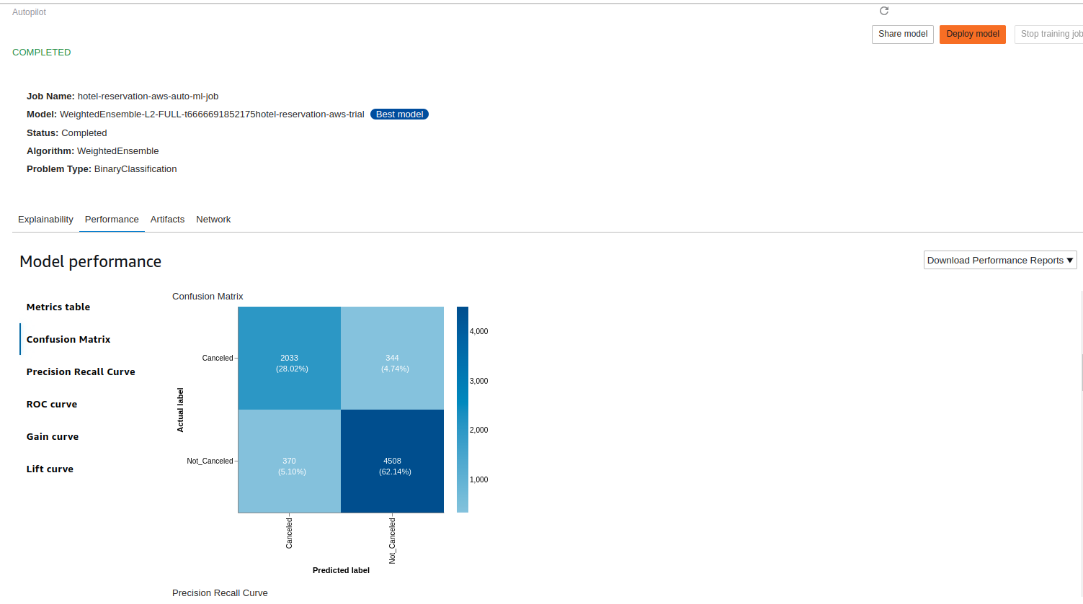
AWS Autopilot: Step 11: Model Performance - Confusion Matrix

Slide 69
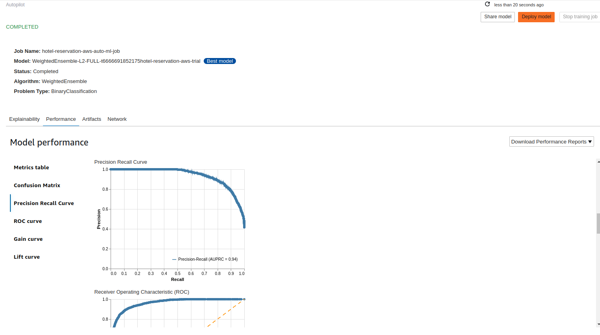
AWS Autopilot: Step 11: Model Performance - Precision Recall Curve

Slide 70
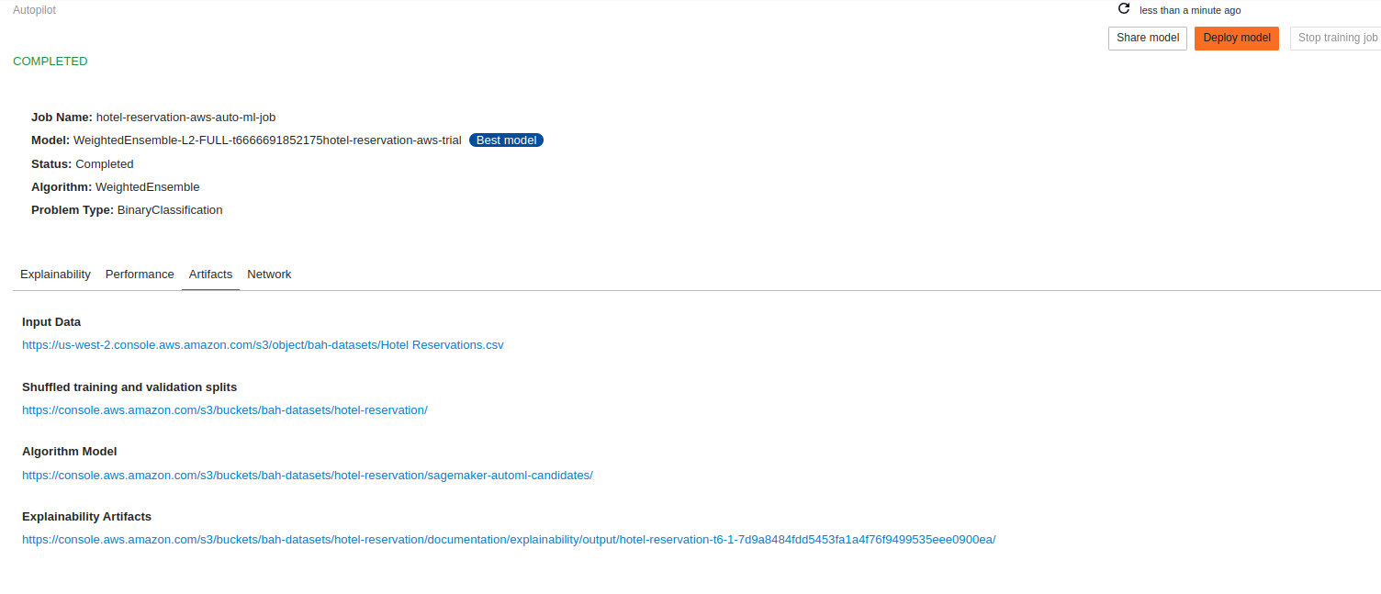
AWS Autopilot: Step 12: Model Artifacts

